Slide 1

DevOps & Cloud Infrastructure SEIS 665 DevOps Practices
Jason Baker
Adjunct Instructor
Graduate Programs in Software
University of St. Thomas
St. Paul, MN

Slide 2
Agenda
DevOps
Lean theory
DevOps Culture
Design For Operations
Infrastructure as code
Code Pipeline

Slide 3
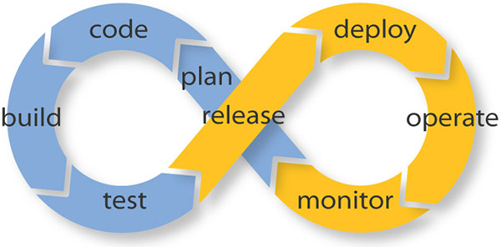
DevOps
A collaborative effort to improve the quality and velocity of the service lifecycle.

Slide 4
Is DevOps really new?
Operations staff have been automating system configurations for decades
Shell scripts
PXE boots
VMWare templates
Developers have also been automating software releases as well.
Make, Ant, SVN…
DevOps builds upon decades of practices, but we still have challenges...

Slide 6
Common DevOps Misconceptions
“We have to hire special DevOps people and build a DevOps team.”

Slide 7
Common DevOps Misconceptions
“DevOps is just about automating all the things.”
DevOps is mostly about culture and building a shared responsibility for service delivery.

Slide 8
Common DevOps Misconceptions
“We use DevOps tools therefore we must be doing DevOps.”
Vendors can sell you tools, but you cannot buy culture.

Slide 9
DevOps CALMS Framework
Culture
Automation
Measurement

Slide 10

DevOps culture and sharing

Slide 12
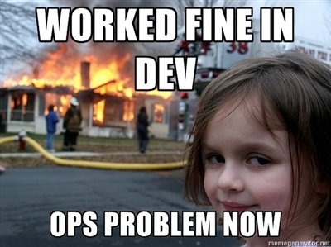

Slide 13

Conflicting measures of success
Development success is measured by the rate of change during a release cycle -- lines of code, code commits, team velocity.
Operations success is measured by service uptime, performance, and resiliency..

Slide 14
Cultural priorities
Collaborative
Teams are multi-disciplined and focused on service delivery (the greater good).
Transparent
People share information with one another.
Blame-less environment
Change oriented
Change is expected and embraced.

Slide 15
Cultural priorities

Slide 16
Does my organization have a DevOps culture?
Do our developers and operations team members sit near one another and go to lunch together?
Do operations people regularly attend inception, showcase, and retrospective development meetings?
And do developers go to operations standups?
Do developers understand in detail how their code is deployed?

Slide 17

DevOps Culture & Lean
DevOps culture is heavily influenced by Lean practices.
Lean is a wide-spread methodology in manufacturing.
Commonly implemented as Six Sigma practices
Goals:
Eliminate waste within a system (“Muda”)
Improve product quality
Respect for people
Continuous improvement (“Kaizen”)

Slide 18
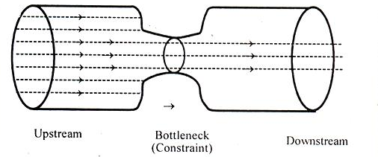
Theory of Constraints
Developed by Eli Goldratt:
Think of your process as a chain of links.
Improving strong links doesn’t strengthen the chain.
Improve the weakest link first.

Slide 19
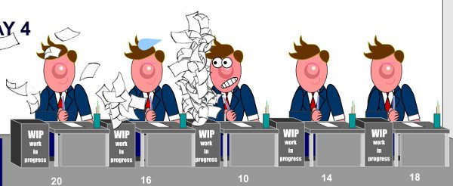
Theory of Constraints
Example: If it requires 40 hours of effort to test a release and 10 minutes to deploy it, then the testing process is a constraint on improving cycle time.

Slide 20
Lean Queuing Theory
What happens when we push work through a complex system?
Traditional utilization thinking: focus on operating resources at peak capacity.
Optimize locally rather than at the system level.
Throughput thinking: focus on identifying the constraints that reduce delivery effectiveness.
Source: https://less.works/less/principles/queueing_theory.html

Slide 21
Lean Queuing Theory
Software development is a stochastic system with queues (non-linear and non-deterministic).
Behavior of this type of system defies our instincts.
Large projects (batch sizes) increase cycle time.
Take longer to process leading to variability and more queues
Increasing worker utilization (just work harder) makes it worse!!
Little’s Law: The only way to maximize throughput is by minimizing Work In Progress (WIP) through the system using small batch sizes.
Example: Small Agile sprints or Kanban tasks
Source: https://less.works/less/principles/queueing_theory.html

Slide 22
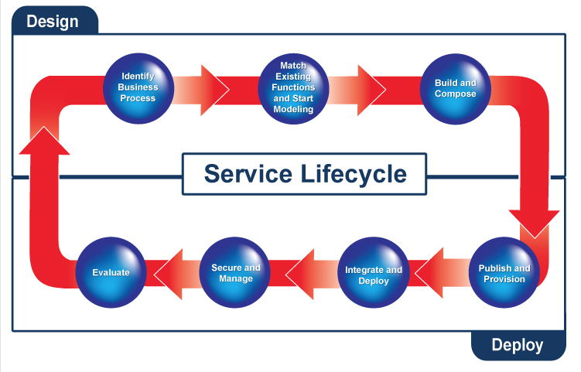
Developer-land
Operations-land

Slide 23
DevOps Organization Focus
Developers more focused on earlier phases of lifecycle.
Operations more focused on later phases of lifecycle.
Shared accountability for service delivery.
Identify requirements
Modeling
Build & Compose
Publish & Provision
Integrate & Deploy
Secure & Manage
Operations
Focus level
Developers

Slide 24
Design For Operations
Problem: Software designs oftentimes don’t account for deployment, management, and support phases.
Non-functional requirements:
How will we scale this feature?
How will we provide high availability?
How will our customer service team support this?
In a DevOps culture, operations staff participate in software planning discussions.
Operations ensures non-functional requirements are part of the software design.
Availability, Scalability, Upgradeability, Supportability, Testability, etc.

Slide 25
Developers role
Developers participate in service delivery and support.
Builds accountability: “Eat your own dog food”.
Developers are part of the on-call support team.
If Developers provide service delivery support, do they get root?
Not necessarily, but they should have enough access to troubleshoot common issues.
Full access to all infrastructure and application logs.
Full access to metrics.
Ability to remediate issues by pushing out corrective updates.

Slide 26
Transparency
In DevOps organizations, staff are empowered to improve quality.
Lean principle: anyone can stop the production line at any time.
Everyone works together to solve the quality problem.
It’s the highest priority job.
Service issues are addressed at postmortem meetings.
Scheduled no later than 48 hours after incidents.
Focus on determining root cause, not assigning blame,
Corrective action given the highest priority.

Slide 27
Transparency
A transparent, blameless environment is a safer environment for employees.
More willing to participate in discussions and raise awareness of potential problems.
Employees won’t hide mistakes.
More willing to experiment and test ways to improve the service.
Survey statistics show that employees are happier in this environment.

Slide 28
Embrace Change
DevOps cultures recognize that change is inevitable, so they embrace it.
Lean/Agile: Smaller batch sizes = increasing rate of change.
The more we change, the better we get at it.
Sports teams can’t get together every 3 months and expect to win a championship. They have to practice.
Learn to change often:
Monthly -> Weekly -> Daily -> Hourly
Should be able to push most changes at any time of day without impacting services.
Amazon & Netflix deploy thousands of times a day.

Slide 29
Embrace Change
But some changes can’t happen in the middle of the day like database schema changes, right?
Many database changes do not require a service maintenance window if designed and sequenced carefully.
Zero Downtime Deployment strategy
Change process may require multiple software updates to transform the schema from one version to another.
Evolutionary Database Design
This process is hard for traditional organizations because their cycle time is too long.
It’s easier for them to just disrupt the service and push out the changes.

Slide 30

Automation

Slide 31
Automation
DevOps mantra: Automate everything.
Humans are brittle.
Processes must be repeatable.
Best way to reduce cycle time and improve quality.
Most cost effective way to scale work.

Slide 32
Software Assembly Line
DevOps treats software development like an automated manufacturing line.
Design the product
Assemble it
Test it
Package it for deployment
Work moves through the company, queuing up at various stations.
For example: product backlog and QA tests are very visible sorts of queues.

Slide 33
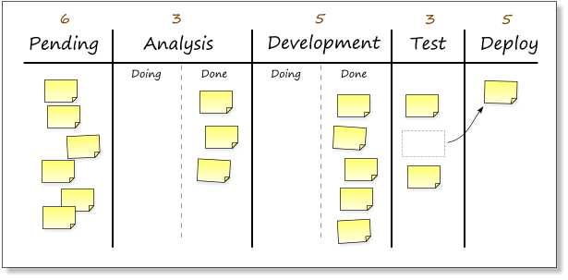
Software Assembly Line
Example: Kanban board showing queues

Slide 34
Code Pipeline
A code pipeline is an automated process for getting software from version control into the hands of your users.
Key benefits to this pattern:
Effectively prevents the deployment of code that has not been thoroughly tested.
Development and release process becomes rapid, repeatable, and reliable.
Releases become normal events and can occur much more frequently.
Source: Continuous Delivery, Humble & Farley

Slide 35
Code pipeline enables continuous change flow.

Slide 36
Code Pipeline

Slide 37
Continuous Integration
Continuous integration is a process used in the first stage of the code pipeline.
Originated as part of Extreme Programming (XP) practices.
Traditionally, developers would merge code changes once a day and do a nightly build.
Don’t break the build!
Developers would work on separate long-running feature branches and face “merge hell” when trying to merge branches months later.

Slide 38

Continuous Integration Practices
Developers check-in code at least once a day to the same mainline (master) branch.
Code is built and unit tested at every check-in.
Everyone can view the build and test reports.
Code committed to the mainline branch may be deployed to production.
Deliverables are stored in an artifact repository and deployed to other test environments after a successful build.
Source: www.continuousdelivery.nu

Slide 40
Software testing automation
Committed code is automatically tested in a series of stages providing greater assurance of working software.
Oftentimes companies focus their efforts on discovering defects versus preventing defects.
Manual exploratory testing
End-to-end testing
User Acceptance testing

Slide 41
Software testing automation
DevOps adopts lessons from Lean.

Slide 42
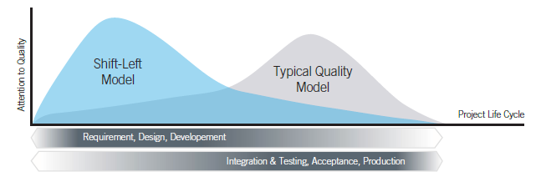

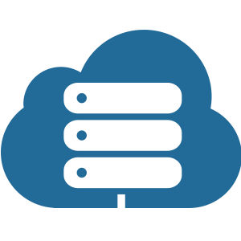
Shift Left
DevOps adopts a “Shift Left” Lean alignment to increase focus on quality issues earlier in the development process.

Slide 43
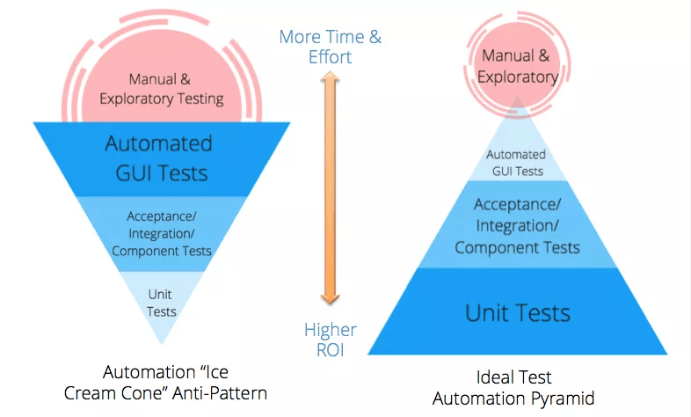
Shift Left

Slide 44
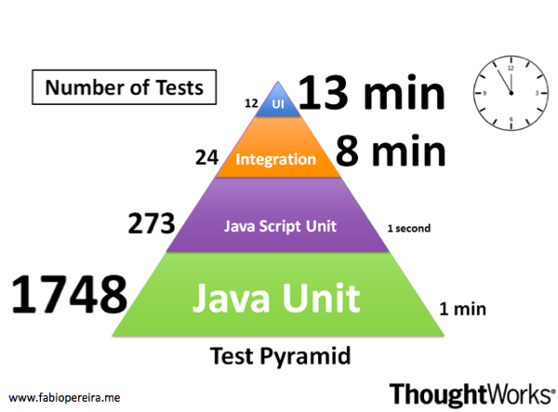
Shift Left

Slide 45
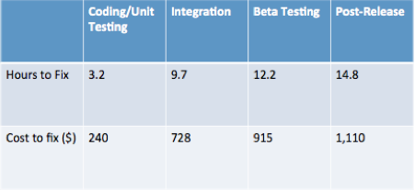
Shift Left
Shifting left improves quality and reduces costs.
Easier to automate testing when the test is done as close to the code as possible (bake quality into the product).
Easier for a developer to fix a defect found earlier in the dev process.
Data Source: (Planning Report 02-3, “The Economic Impacts of Inadequate Infrastructure for Software Testing,” Prepared by RTI for National Institute of Standards and Technology, May 2002, p 7-12.)

Slide 46
GUI test anti-pattern
GUI app tests use tools like Selenium to simulate web client access.
These tests are slow, expensive to maintain, and non-deterministic.
Yet many companies still focus the majority of their testing effort writing these types of tests!
Non-deterministic tests are dangerous.
False positives lead to alarm fatigue.
False negatives lead to production outages.
A non-deterministic test is worse than no test at all!

Slide 47
GUI test anti-pattern
Modern testing practices:
Limit the use of automated GUI tests to key application workflows.
Leverage unit and API/integration tests for the majority of your automated testing.
Build test endpoints into your API to make it easier to test application.
Manufacturers build test harness interfaces into things like engines to make them easier to test during assembly.
Eliminate or quarantine any non-deterministic tests.
100% of the tests in your test suite should pass!

Slide 48
The "hardening" anti-pattern
Many companies still implement a "hardening" phase where they test code much later in the delivery cycle.
Code is always being tested in a continuous delivery process, eliminating the need for hardening.

Slide 49
Continuous Delivery
A continuous delivery process ensures that software is deployable throughout its lifecycle.
Team prioritizes keeping the software deployable over working on new features.
All parts of the pipeline are extensively automated including the deployment environment.
Done means released!

Slide 50
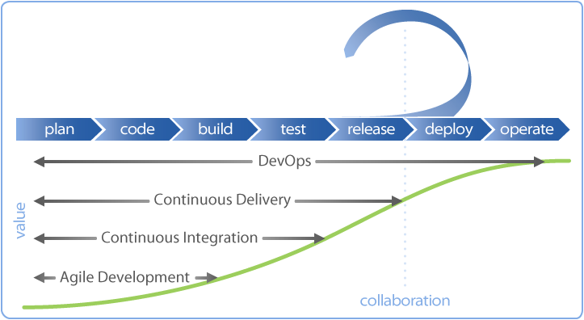
Continuous Delivery

Slide 51
Traditional software delivery
Traditionally, in IT we managed the risk of introducing change by:
Changing infrequently and only when absolutely necessary.
Changing at inconvenient times when staff and vendors are at their lowest performance levels.
Batching changes during change windows.

Slide 52
Traditional software delivery
Big-bang: everyone experiences change simultaneously
Production testing after release. Spray and pray!
Deployments scheduled at inconvenient hours.
Rolling back requires another deployment. Uh, oh!

Slide 53
DevOps software delivery
Software changes are delivered frequently and in small batches (Little's Law!).
Frequent software deployments allow us to deliver value faster and with lower risk.
Recall change failure rates for high performing organizations.

Slide 54
DevOps software delivery

Slide 55
DevOps software delivery
Small changes allow us to minimize the impact or "blast radius" of change.

Slide 56
Deployments vs. releases
Deployment: installation of new software code in an environment.
Release: making new software code available to customers.
One of the keys to successful continuous delivery is decoupling deployments from releases.

Slide 57
Deployments vs. releases
Dear valued customer, we are upgrading our health care platform tomorrow. You are required to upgrade your mobile app promptly at 2:35am CST tomorrow to continue to use our platform.

Slide 58
Deployments vs. releases
Need to support multiple versions of services running concurrently.
We will always have a cutover window (unless we quiesce traffic).
Version your APIs and API payloads.
Leverage feature flags/toggles.

Slide 59
Feature Flag Pattern
Code changes are wrapped in an if-then-else block which is controlled by a configuration variable.
Configuration variable allows you to enable/disable feature in different environments.
Work-in-progress features are deployed in production. WHAT??
This process decreases software integration risks.

Slide 60
Infrastructure as Code
An approach to infrastructure automation based on practices used in software development.
Versionable, Testable, Repeatable
Goals
Infrastructure supports change and is no longer an obstacle.
Infrastructure change is routine.
Improvements are made continuously versus big bang releases.

Slide 61
Measurement

Slide 62
Measurement
DevOps organizations fanatically collect data.
Essential feedback mechanism for improving services and validating changes.
Collect data from diverse resources and store in a central repository.
Time-series and unstructured data
Make it easy to search data to identify trends and correlations.

Slide 63
Telemetry types
Events: point-in-time occurrences of significant activities.
Login, payment, deployment
Logs: application diagnostic information and errors.
Website access logs, Lambda execution logs, audit logs
Metrics: observable application and environment properties.
Memory utilization, Lambda latency, DynamoDB reads
Traces: measured application execution paths.
Stack traces, AWS X-ray, APM

Slide 64
Telemetry sources
Telemetry sources
Business
Application
Infrastructure
Client software
Sign ups
Churn
Incidents
Messages/s
Transaction times
Service latency
Errors
Network utilization
Resource throttling
CPU utilization
App errors
Response time

Slide 65
Telemetry development
Development teams determine what to measure.
Dashboards
Instrumenting code
Definition of Done = it can be measured

Slide 66
Telemetry development
Iteratively improve telemetry:
Incident occurs
Postmortem: What telemetry could we have implemented to predict this incident?
Implement telemetry and add an alert.
Go back to step 1.

Slide 67
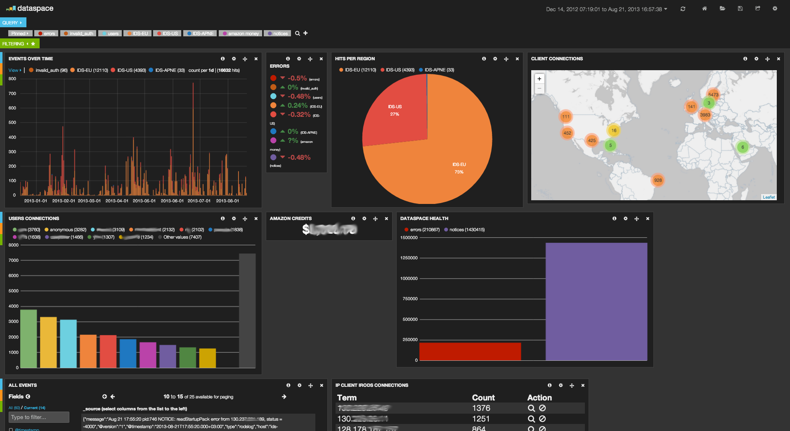
Telemetry instrumentation
ELK stack (Elasticsearch + Logstash + Kibana)

Slide 68
Telemetry alarms
Generate notifications to alert staff on service issues.
Weed out non-actionable notifications (log but don’t email) to prevent alarm fatigue.
Example: failing infrastructure is not actionable if the service is self-healing.
Caveat: If a service is self-healing at a greater than expected rate, that might be actionable.

Slide 69

Measurement and decision-making
Measurement drives decision-making in high performing DevOps organizations.
Sometimes our technical solutions are educated guesses.
“I think if we add more memory the app performance will improve.”
Use metrics to strengthen recommendations.
Any recommendation not supported by data is considered a guess and is therefore risky.
Cloud infrastructure gives us a cheap way to run experiments.

Slide 70

Parting Notes
You cannot change a traditional IT organization into a DevOps unicorn overnight.
Start small, prove out the effectiveness of new patterns and celebrate successes.
Culture is the hard part.

